Slide 1
EE-2003 Computer Organization & Assembly Language
INSTRUCTOR
Engr. Aashir Mahboob
Lecturer, Department of Computer Science
FAST NUCES (Karachi)
aashir.mahboob@nu.edu.pk

Slide 2
Chapter No: 04
Data Transfers, Addressing, and Arithmetic

Slide 3
OUTLINE
DATA TRANSFER INSTRUCTIONS
ADDITION AND SUBTRACTION
DATA RELATED OPERATORS AND DIRECTIVES
INDIRECT ADDRESSING
JMP AND LOOP INSTRUCTIONS

Slide 4
DATA TRANSFER INSTRUCTION
Operand Types
•Instructions in assembly language can have zero, one, two, or three operands.
•mnemonic
•mnemonic [destination]
•mnemonic [destination],[source]
•mnemonic [destination],[source1],[source2]

Slide 5
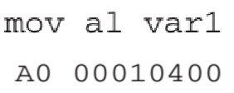
DATA TRANSFER INSTRUCTION
•The three types of operands are:
1. Immediate: a numeric literal expression /a constant integer (8, 16, or 32 bits), value is encoded within the instruction.
2. Register: the name of a register, register name is converted to a number and encoded within the instruction.
3. Memory: references a location in memory, memory address is encoded within the instruction, or a register holds the address of a memory location.

Slide 6
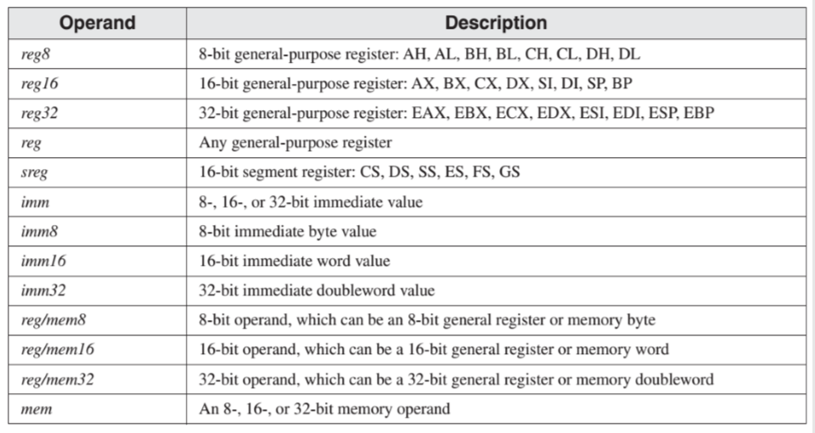
DATA TRANSFER INSTRUCTION

Slide 7
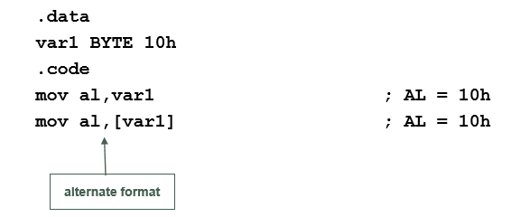
DATA TRANSFER INSTRUCTION
Direct Memory Operands
•Variable names are references to offsets within the data segment.
•A direct memory operand is a named reference to storage in memory.
•The named reference (label) is automatically dereferenced by the assembler.

Slide 8
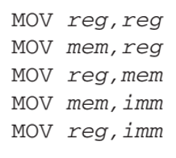
MOV INSTRUCTION
•The MOV instruction copies data from a source operand to a destination operand. Known as a data transfer instruction.
MOV destination,source
•Both operands must be the same size.
•Both operands cannot be memory operands.
•The instruction pointer register (IP, EIP) and CS cannot be a destination operand.

Slide 9
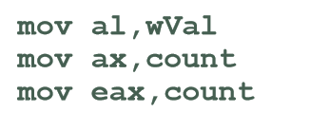
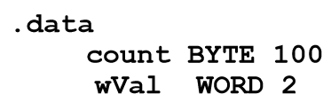
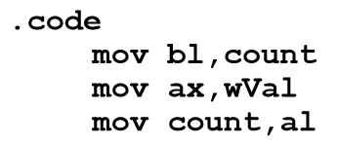
MOV INSTRUCTION
ABOVE INSTRUCTIONS ARE CORRECT??
Mistakes??
ABOVE INSTRUCTIONS ARE CORRECT??

Slide 10
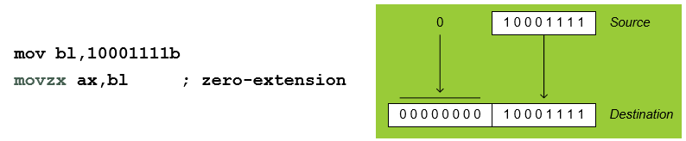
MOVZX INSTRUCTION
Zero Extension
•MOV instruction cannot directly copy data from a smaller operand to a larger one.
mov bl,10001111b
mov ax,bl ; error
•MOVZX (move with zero-extend) instruction fills (extends) the upper half of the destination with zeros.

Slide 11
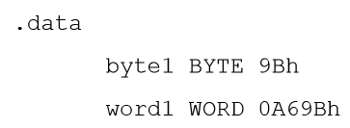
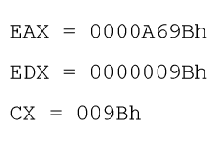
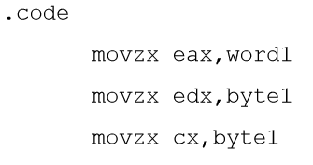
EXERCISE
Write down values of registers

Slide 12
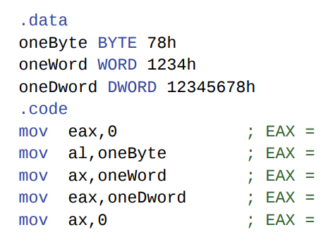
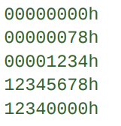
EXERCISE
Write down values of registers

Slide 13
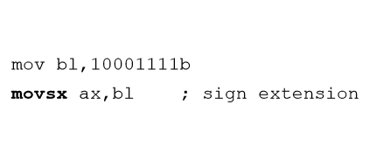
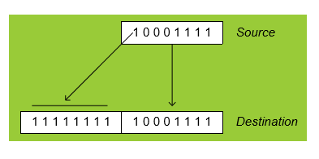
MOVSX INSTRUCTION
The MOVSX instruction (move with sign-extend) copies the contents of a source operand into a destination operand and fills the upper half of the destination with a copy of the source operand's sign bit.

Slide 14


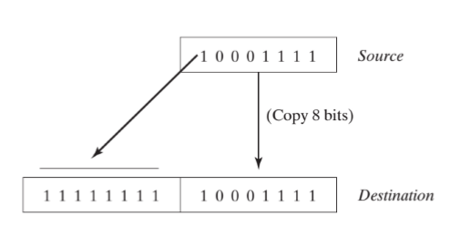

EXERCISE
Write down values ax.

Slide 15


XCHG INSTRUCTION
The XCHG (exchange data) instruction exchanges the contents of two operands.
There are three variants:
You can exchange data between registers or between registers and memory, but not from memory to memory:

Slide 16
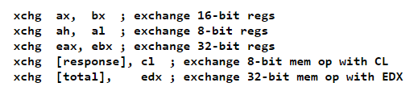
XCHG INSTRUCTION
The rules for operands in the XCHG instruction are the same as those for the MOV instruction...
...except that XCHG does not accept immediate operands.
In array sorting applications, XCHG provides a simple way to exchange two array elements.

Slide 17

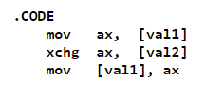
EXERCISE
Write down contents of ax
And memory locations after
Execution of each instruction.

Slide 18

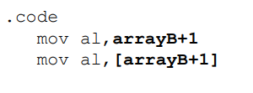
Direct-Offset Operands
lets you access memory locations that may not have explicit labels.
A constant is added to a data label to produce an effective address (EA). The address is dereferenced to get the value inside its memory location.

Slide 19

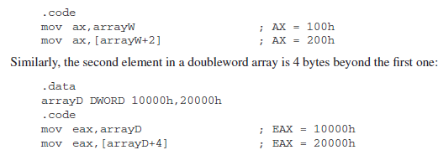
Direct-Offset Operands
WORD Arrays; In an array of 16-bit words, the offset of each array element is 2 bytes beyond the previous one.
That’s why 2 is added as offset in Array (for each next element of an array)
DWORD Arrays; In an array of 32-bit words, the offset of each array element is 4 bytes beyond the previous one.
That’s why 4 is added as offset in Array (for each next element of an array)

Slide 20
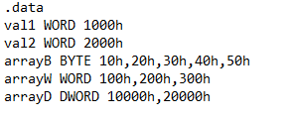
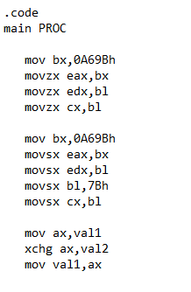
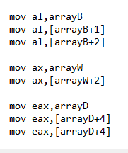
EXAMPLE PROGRAM (MOVES)

Slide 21

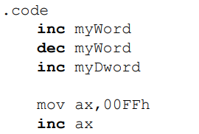
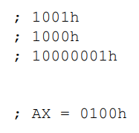
ADDITION AND SUBTRACTION
INC and DEC Instructions
•The INC (increment) and DEC (decrement) instructions, respectively, add 1 and subtract 1 from a register or memory operand.

Slide 22


ADDITION AND SUBTRACTION
ADD Instruction
The ADD instruction adds a source operand to a destination operand of the same size.
SUB Instruction
The SUB instruction subtracts a source operand from a destination operand.
•The set of possible operands is the same as for the MOV instruction

Slide 23
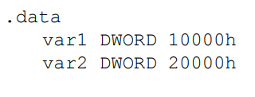
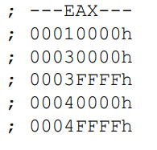
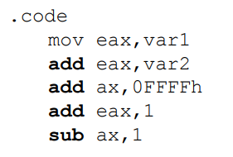
ADDITION AND SUBTRACTION

Slide 24

NEG Instruction
The neg (negate) instruction takes the two's complement of a byte or word.
It takes a single (destination) operation and negates it. The syntax for this instruction is:
Neg always updates the A, S, P, and Z flags as though you were using the sub instruction.

Slide 25

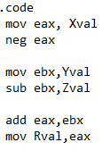

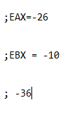
Implementing Arithmetic Expressions
HLL compilers translate mathematical expressions into assembly language. You can do it also. For example:

Slide 26
Flags Affected by Addition and Subtraction
•The ALU has a number of status flags that reflect the outcome of arithmetic (and bitwise) operations.
• based on the contents of the destination operand.
•We use the values of CPU status flags to check the outcome of arithmetic operations and to activate conditional branching instructions.
•Essential flags:
Zero flag – set when destination equals zero
Sign flag – set when destination is negative; if the MSB of the destination operand is set,
Carry flag – set when unsigned value is out of range.
Overflow flag – set when signed value is out of range .

Slide 27
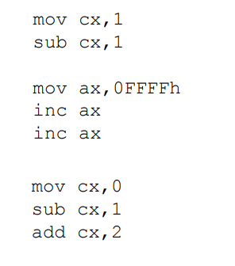
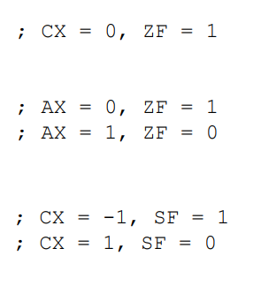
Flags Affected by Addition and Subtraction

Slide 28
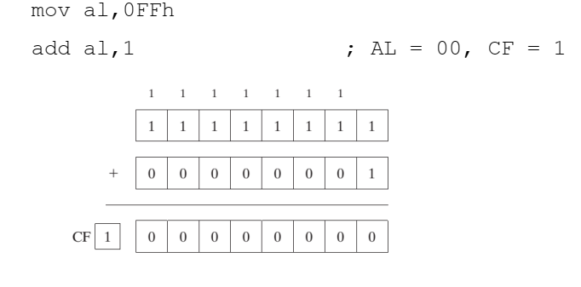
ADD & SUB Instructions
Example:

Slide 29
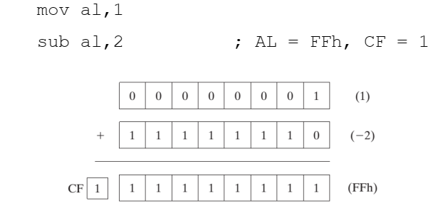
ADD & SUB Instructions
Example:

Slide 30

ADD & SUB Instructions
Sign and Overflow Flags:
The Sign flag is set when the result of a signed arithmetic operation is negative.
The Overflow flag is set when the result of a signed arithmetic operation overflows or underflows the destination operand.

Slide 31
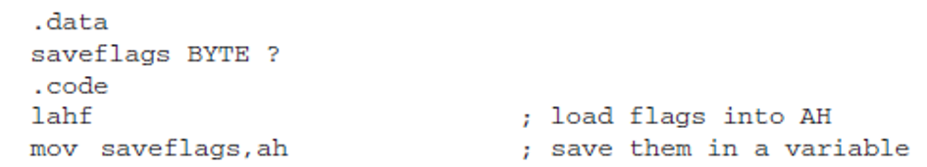
LAHF/SAHF (load/store status flag from/to AH)
LAHF instruction loads lower byte of the EFLAGS register into AH register.
The lowest 8 bits of the flags are transferred:
Sign
Zero
Auxiliary Carry
Parity
Carry

Slide 32
LAHF/SAHF (load/store status flag from/to AH)
SAHF restores the value of lower byte flags.
This instruction copies, AH into low byte of EFLAGS Register.

Slide 33
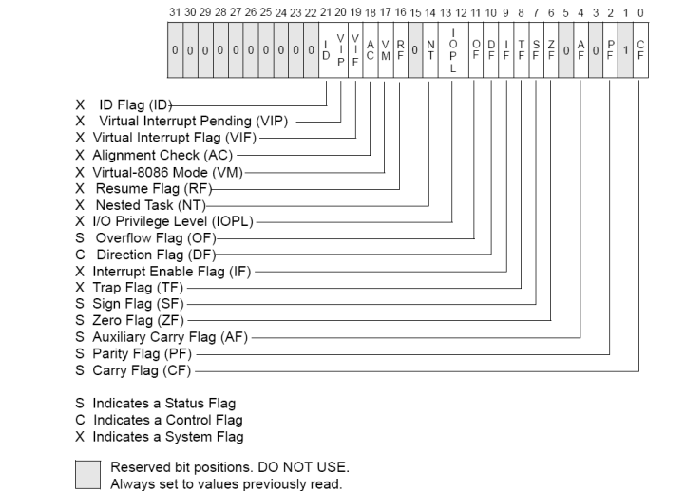
EFLAGS

Slide 34
ALIGN DIRECTIVE
The ALIGN directive aligns a variable on a byte, word, doubleword, or paragraph boundary.
The syntax is :
ALIGN bound
Bound can be 1, 2, 4, 8, or 16. A value of 1 aligns the next variable on a 1- byte boundary (the default).
If bound is 2, the next variable is aligned on an even-numbered address. If bound is 4, the next address is a multiple of 4. If bound is 16, the next address is a multiple of 16, a paragraph boundary.

Slide 35
ALIGN DIRECTIVE
The assembler can insert one or more empty bytes before the variable to fix the alignment.
Why bother aligning data?
Because the CPU can process data stored at even-numbered addresses more quickly than those at odd-numbered addresses.

Slide 36
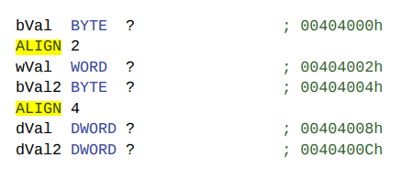
ALIGN DIRECTIVE
In the following example, bVal is arbitrarily located at offset 00404000. Inserting the ALIGN 2 directive before wVal causes it to be assigned an even-numbered offset:
Note that dVal would have been at offset 00404005, but the ALIGN 4 directive bumped it up to offset 00404008.

Slide 37
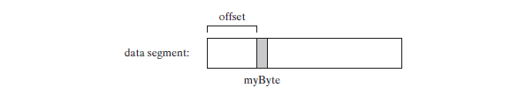
OFFSET Operator
The OFFSET operator return the offset of a data label
The offset represents the distance, in bytes, of the label from beginning of the data segment
Figure shows a variable named myByte inside the data segment

Slide 38
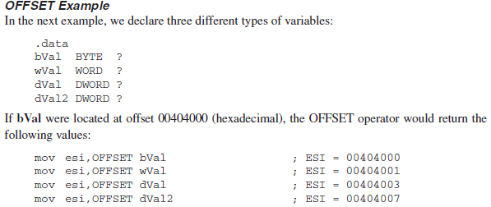
OFFSET Operator
Example:
Declaration of different types:
If bVal were located at offset 00404000 (hexa-decimal), the OFFSET operator would return the following values:

Slide 39
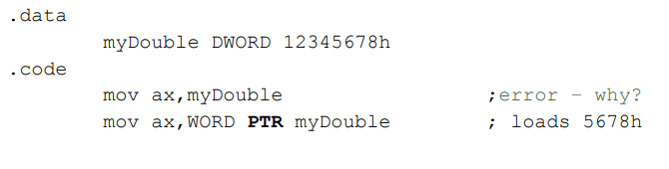
PTR Operator
You can use the PTR operator to override the declared size of an operand.
Why wasn’t 1234h moved into AX?
x86 processors use the little endian storage format in which the low-order byte is stored at the variable’s starting address.

Slide 40
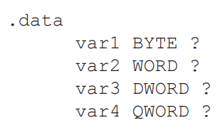
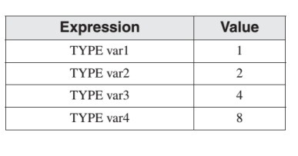
TYPE Operator
The TYPE operator returns the size, in bytes, of a single element of a data declaration.

Slide 41
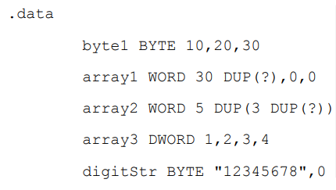
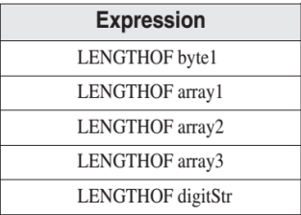
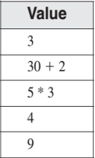

LENGTHOF Operator
The LENGTHOF operator counts the number of elements in an array, defined by the values appearing on the same line as its label.
If you declare an array that spans multiple program lines, LENGTHOF only regards the data from the first line as part of the array (here LENGTHOF myArray returns 5).

Slide 42
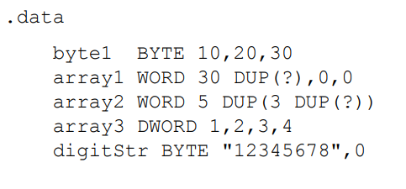



SIZEOF Operator
The SIZEOF operator returns a value that is equivalent to multiplying LENGTHOF by TYPE.

Slide 43
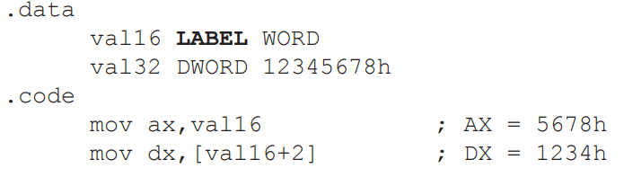
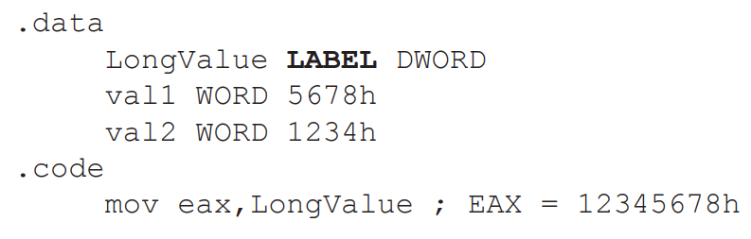
LABEL Directive
The LABEL directive assigns an alternate label name and type to an existing storage location. LABEL does not allocate any storage of its own.
• A common use of LABEL is to provide an alternative name and size attribute for the variable declared next in the data segment.

Slide 44
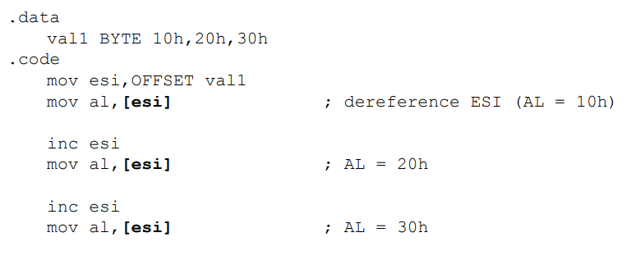
INDIRECT ADDRESSING
Direct addressing is rarely used for array processing because it is impractical to use constant offsets to address more than a few array elements.
An indirect operand holds the address of a variable, usually an array or string. It can be dereferenced (just like a pointer).

Slide 45

INDIRECT ADDRESSING
The size of an operand may not be evident from the context of an instruction.
Because the assembler does not know whether ESI points to a byte, word, doubleword, or some other size. The PTR operator confirms the operand size:

Slide 46
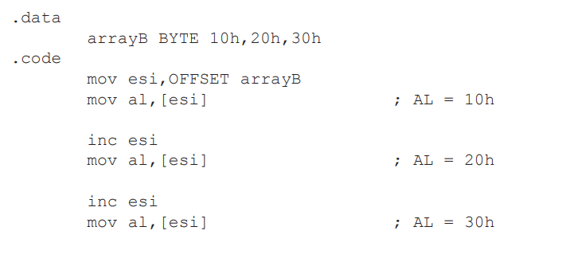
Arrays
Indirect operands are ideal tools for stepping through arrays.

Slide 47

Indexed Operands
An indexed operand adds a constant to a register to generate an effective address. There are two notational forms:
[label + reg] label[reg]

Slide 48

Scale Factors in Indexed Operands
Indexed operands must take into account the size of each array element when calculating offsets.
Using an array of doublewords, as in the following example, we multiply the subscript (3) by 4 (the size of a doubleword) to generate the offset of the array element containing 400h:

Slide 49


Scale Factors in Indexed Operands
The x86 instruction set provides a way for offsets to be calculated, using a scale factor .
The scale factor is the size of the array component (WORD=2, DWORD=4 or QWORD=8 ).

Slide 50


EXERCISE
What will be the value of EAX after each of the following instructions execute?

Slide 51


EXERCISE
Write down values of destination registers

Slide 52


